Slide 1
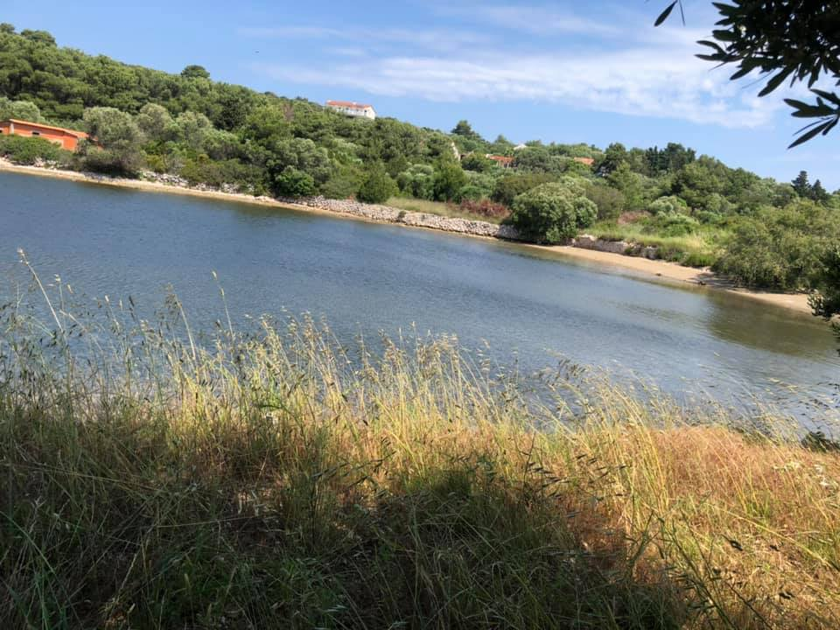
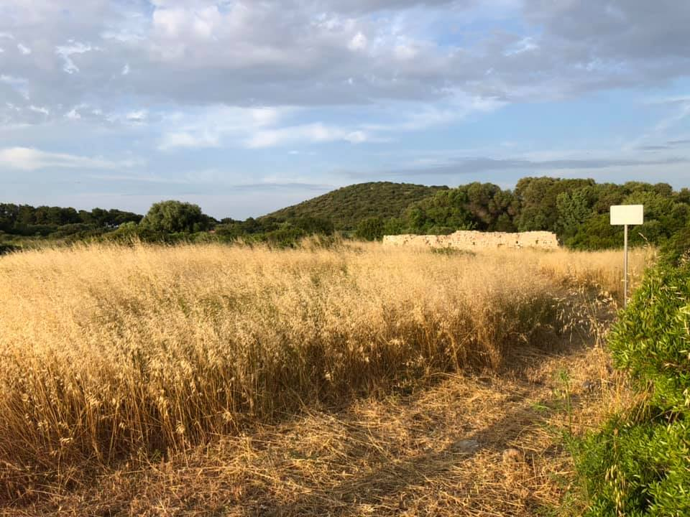
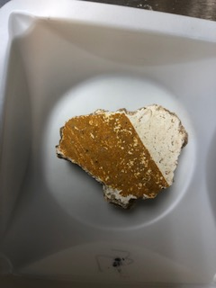
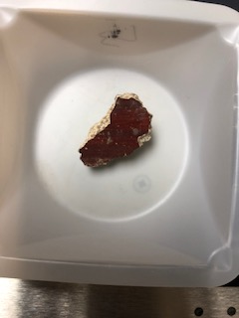
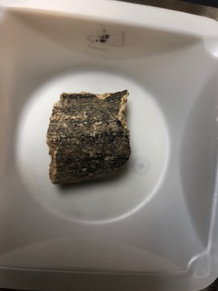
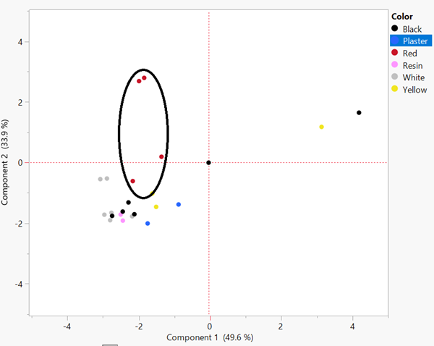
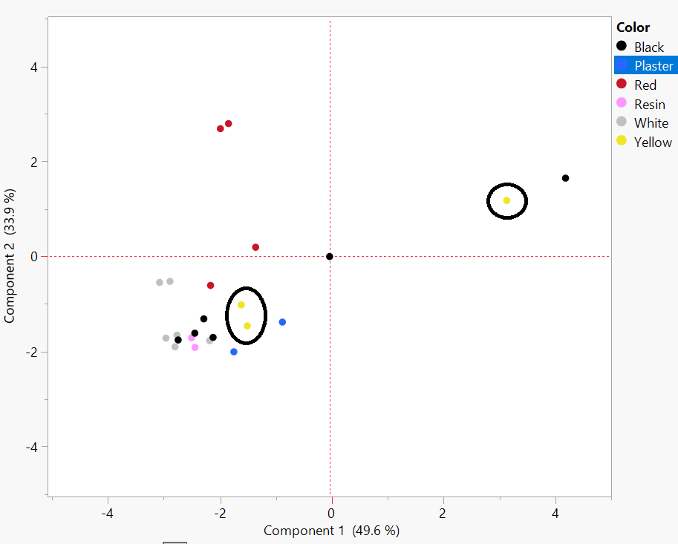
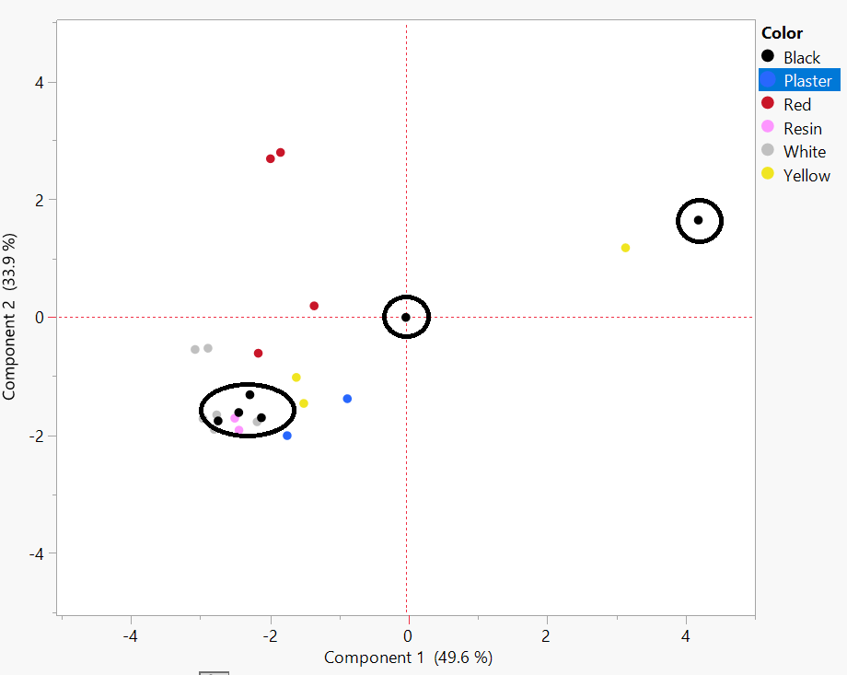
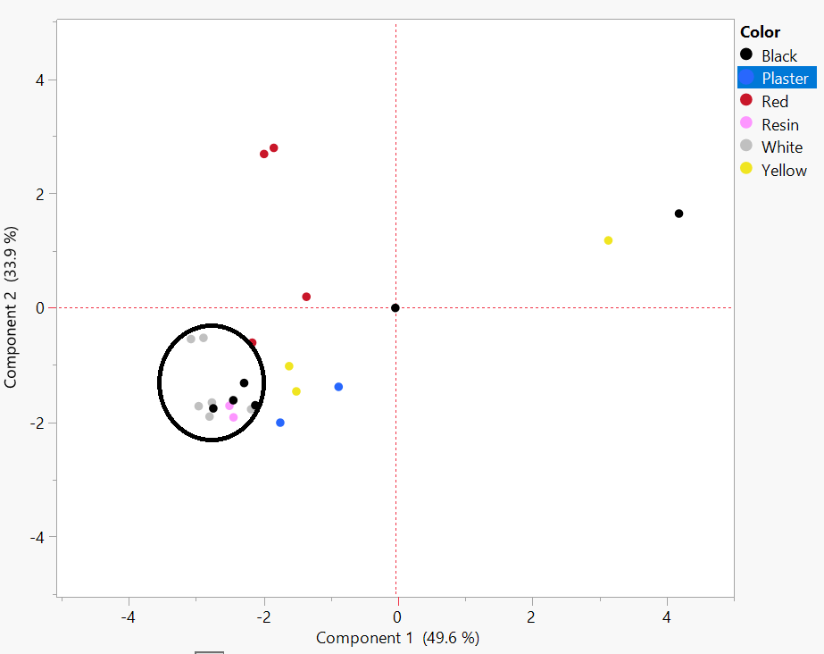
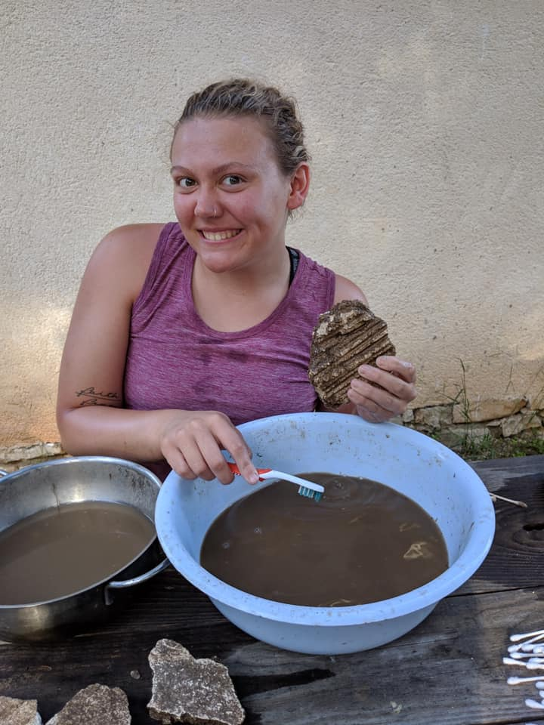
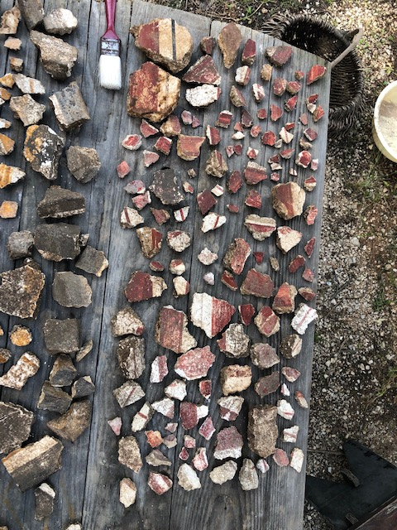
Painting on the Periphery: Roman Wall Painting Analysis at St. Clement, Croatia
Madeline Olson
Background
There is a large rural Roman villa on the island of St. Clement, Croatia near the Soline Bay. It has dated back to the first-sixth century CE with two or more building phases. There has been Croatian-American collaborative and multi-disciplinary archaeological excavations done every summer beginning in 2007.
Wall painting fragments have been found and are the main focus of this research investigation. The wall paintings express a story about the rural villas in the Roman era which is why it is vital to consider the archaeological context. X-ray fluorescent technology (pXRF) has been increasingly used in the fields of art history and archaeology to reveal the elemental profile of these pigments.
The Roman Empire was very vast during this time period and there is not substantial research on rural life villas in the Balkans region of the empire. St. Clement is in a strategic part in the Adriatic and is in the midst of important trade routes even today.
View of Soline Bay from the archaeological excavation site
View of Soline Bay villa and the surrounding landscape from afar
Wall Painting Fragment Sample #4 with White and Yellow Pigment
Wall Painting Fragment Sample #13 with Red Pigment
Wall Painting Fragment Sample #3 with Black Pigment
Methods
Figure 2. Soline Bay at St. Clement
The historical context of my research is grounded in literary sources surrounding the island of St. Clement and the Soline Bay, the surrounding land which was Dalmatia at the time, rural Roman lifestyle, and Roman and Greek Wall Paintings. I used the University of St. Thomas library database for most of my sources and the Interlibrary Loan to request books that were not available in the St. Thomas library database.
I traveled to St. Clement, Croatia to take part in an archaeological excavation and extract wall painting fragments.
I used and performed pXRF analysis using an pXRF analyzer provided by the University of St. Thomas. Statistical analysis using JMP software was used to show groupings of composition of the pigments.
Figure 4. Wall Painting Fragment Samples
Results
The results of the XRF analysis showed that the pigments used at the Soline Bay villa site were largely typical of the time period.
The iron in the red and yellow pigments indicate that these are ochres made with resources from the Earth. Many black pigments were made with soot which was easily produced at high volumes or with very dark earth, except there was a lack of carbon in these samples which is interesting to note. The high percentage of calcium across all the samples is because of the lime substrate that is applied before the pigment is applied.
There are many unknowns still about rural life in the empire, but this villa was most likely owned by a high ranked military officer who had tenants to take care of the crops, salt works, and villa year-round. This villa had a multitude of contact with the world as it is in a vital area that had contact with many ships and different types of people.
Objective
Red Pigment
My research goal is to contribute a new perspective and information on rural life in the Roman Empire using the villa at St. Clement and expanding the comprehensive knowledge on wall painting pigments.
Pigment analysis has been done at many sites but very little has been done in Croatia or the Balkans as a whole. This research will expand the comprehensive knowledge of pigments on a further diameter of the Empire at this time.
The Soline Bay villa site needs to compare to sites that are geographically and temporally distant which creates gaps between techniques, styles, and resources used for the wall paintings. This analysis and research show how this part of the Roman world is underrepresented in wall painting studies and needs so much more attention.
With this new perspective and information on rural life in the Roman Empire I will be able to compare this settlement to other rural settlements. This will then lead to wider possible comparisons between everyday life in the periphery of the Roman Empire to further make known vital information about the citizens who lived in the rural part of the empire. My research will investigate information about trade networks, economic and social choices, and relationships between the center and periphery of Roman society.
Yellow Pigment
Color | Sample # | Major (%) | Trace (%)
Accretion | 2 | Bal 55.492 Ca 44.2 | Sr 0.022 Fe 0.158 K 0.096
Accretion | 5 | Bal 59.589 Ca 39.665 | Pb 0.002 Zn 0.003 Cu 0.004 Fe 0.427 Mn 0.018 Ti 0.035 K 0.221
Plaster | 5 | Bal 66.859 Ca 32.37 | Sr 0.028 Zn 0.002 Fe 0.4 Ti 0.049 K 0.287
Plaster | 14 | Bal 63.098 Ca 36.163 | Sr 0.028 Pb 0.002 Fe 0.418 Mn 0.015 Cr 0.014 Ti 0.05 K 0.207
Red | 7 | Bal 57.137 Fe 3.834 Ca 38.709 | Sr 0.012 As 0.039 Pb 0.014 Zn 0.013 Mn 0.019 Cr 0.013 V 0.007 Ti 0.057 K 0.14
Red | 9 | Bal 58.111 Fe 2.448 Ca 39.222 | Sr 0.016 As 0.024 Pb 0.005 Zn 0.007 Ni 0.006 Cr 0.011 Ti 0.033 K 0.109
Red | 11 | Bal 59.365 Ca 39.538 | Sr 0.013 As 0.008 Pb 0.004 Zn 0.004 Fe 0.883 Cr 0.008 Ti 0.031 K 0.142
Red | 13 | Bal 65.844 Fe 5.809 Ca 28.061 | Sr 0.016 As 0.067 Pb 0.006 Zn 0.016 Cr 0.014 Ti 0.038 K 0.118
Yellow | 4 | Bal 63.838 Fe 6.29 Ca 29.009 | Sr 0.018 As 0.002 Pb 0.003 Zn 0.005 Cu 0.045 Ni 0.012 Mn 0.032 Cr 0.021 V 0.023 Ti 0.154 K 0.545
Yellow | 8 | Bal 60.398 Ca 38.279 | Sr 0.014 Pb 0.002 Zn 0.002 Cu 0.002 Fe 0.993 Cr 0.009 Ti 0.052 K 0.243
Yellow | 14 | Bal 57.276 Ca 41.505 | Sr 0.013 Zn 0.002 Fe 0.959 Cr 0.006 V 0.006 Ti 0.058 K 0.171
Black | 3 | Bal 58.067 Ca 41.497 | Sr 0.028 Pb 0.003 Zn 0.003 Fe 0.201 Mn 0.015 Ti 0.02 K 0.163
Black | 6 | Bal 55.14 Ca 44.473 | Sr 0.007 As 0.002 Pb 0.003 Fe 0.182 Cr 0.008 Ti 0.021 K 0.154
Black | 8 | Bal 55.925 Ca 43.786 | Sr 0.024 Pb 0.004 Zn 0.002 Fe 0.113 Ti 0.029 K 0.114
Black | 9 | Bal 56.155 Ca 43.586 | Sr 0.01 Pb 0.003 Fe 0.116 Ti 0.032 K 0.088
Black | 10 | Bal 85.443 Fe 4.146 Ca 8.121 K 1.737 | Zr 0.009 Sr 0.016 Rb 0.005 Pb 0.002 Zn 0.009 Mn 0.103 Cr 0.022 V 0.016 Ti 0.366
White | 1 | Bal 52.324 Ca 47.575 | Sr 0.008 Pb 0.002 Zn 0.002 Fe 0.054 K 0.025
White | 4 | Bal 50.746 Ca 49.018 | Sr 0.01 Pb 0.006 Cu 0.064 Fe 0.076 Mn 0.021 K 0.034
White | 6 | Bal 58.149 Ca 41.491 | Sr 0.006 Fe 0.129 Cr 0.006 Ti 0.02 K 0.195
White | 7 | Bal 51.67 Ca 48.085 | Sr 0.009 Pb 0.009 Zn 0.003 Fe 0.145 Cr 0.005 K 0.048
White | 8 | Bal 62.507 Ca 37.248 | Sr 0.009 Pb 0.002 W 0.009 Zn 0.002 Fe 0.104 Ti 0.022 K 0.089
White | 12 | Bal 54.143 Ca 45.732 | Sr 0.009 Pb 0.002 Fe 0.056 Ti 0.024 K 0.033
Black Pigment
White Pigment
Figure 4. JMP Statistical Analysis used to show the groupings of the composition of each pigment
Acknowledgements
This research was funded by the University of St. Thomas through a Young Scholars Grant. My research travel to Croatia was funded by the Undergraduate Research Opportunities Program (UROP) and the University of St. Thomas Department of Art History. I would like to thank my primary faculty mentor, Dr. Vanessa Rousseau of the UST Art History Department, for supporting and guiding my research. I would also like to thank Dr. Ivancica Schrunk of the UST History Department and her Croatian colleagues for the opportunity and guidance during the archaeological dig in at the St. Clement site in Croatia. I also would like to thank Dr. Adam Kay of the UST Biology Department for his assistance with the pXRF analysis. I lastly would like to thank Dr. Hilary Becker of Binghamton University for sharing her extensive knowledge and insight about pigments.
Literature Cited
Begovič, Vlasta and Ivančica Schrunk and Marina Ugarkovič. Roman villa in the Soline cove on the Island of St. Clement near Hvar. Preliminary analysis of the architecture according to geophysical investigations and sondages. In Prilozi: Instituta za arheologiju u Zagrebu 29, 143-166. 2012
Beeston, Ruth F and Hilary Becker. Investigation of Roman Pigments by Portable X-ray Fluorescence Spectroscopy and Polarized Light Microscopy. In Archaeological Chemistry VIII, 19-41. Washington D.C.: American Chemical Society, 2013.
Me carefully cleaning the dirt off the wall fresco fragments from the Soline Bay villa excavation
A small selection of the high multitude of wall fresco fragments found
Figure 1. Processing Wall Painting Fragments at St. Clement
Table 1. Compilation of the samples taken, and the readings received from the XRF analysis. Includes major elemental percentages and minor/trace elemental percentages

